Slide 1
Aggregator Based RPL
Group 13:
Abdul Razique:2023CSM1001
Sravan S Sankar:2023CSM1016
Veligati Srinivasu:2023AIM1016

Slide 2
Contents
Given Analysis are carried out:
Based On No of Messages Aggregated
Based on the Position of Aggregator
Based on the Number of Aggregators Used

Slide 3
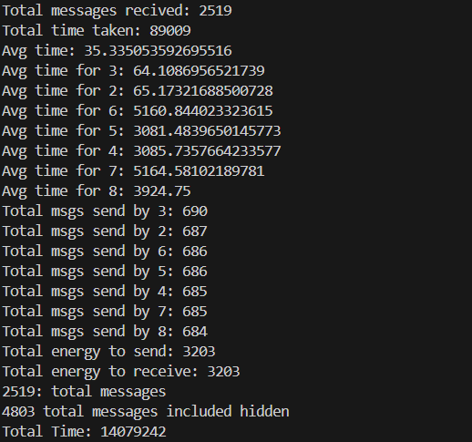
A Sample Output

Slide 4
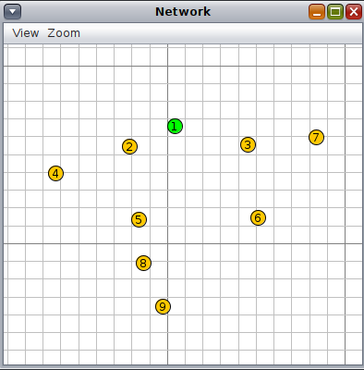
Analysis Based on Number of Messages Aggregated:
Topology used

Slide 5
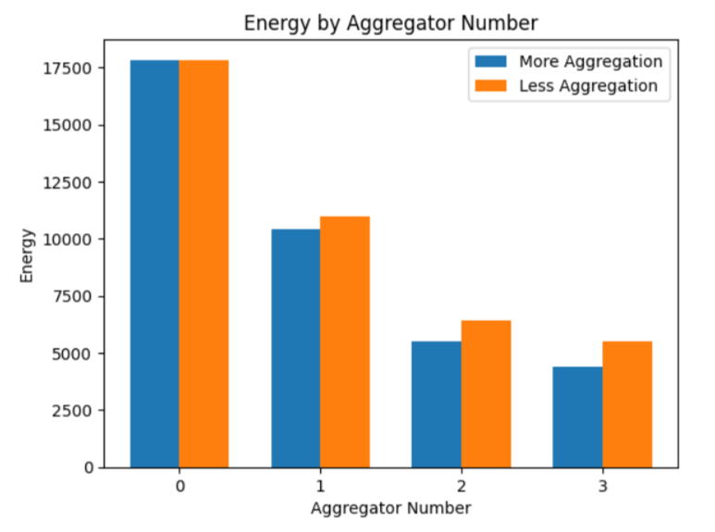
ENERGY ANALYSIS

Slide 6
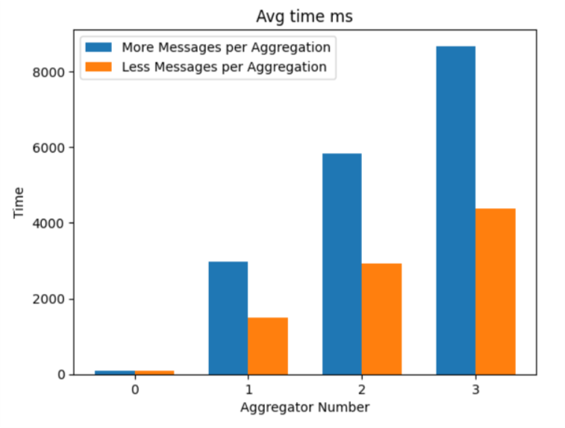
TIME ANALYSIS

Slide 7
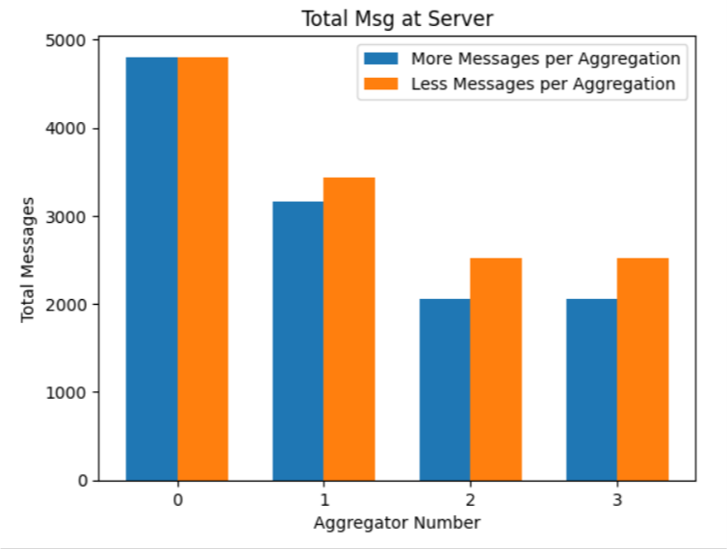
TOT. MESSAGE ANALYSIS

Slide 8
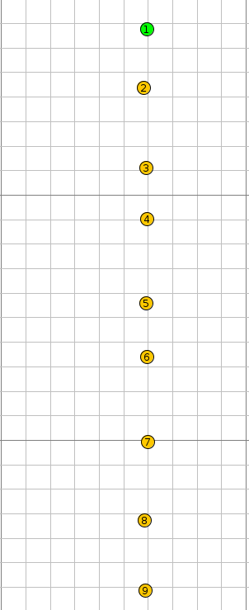
Analysis Based on Position of Aggregators
Topology used

Slide 9
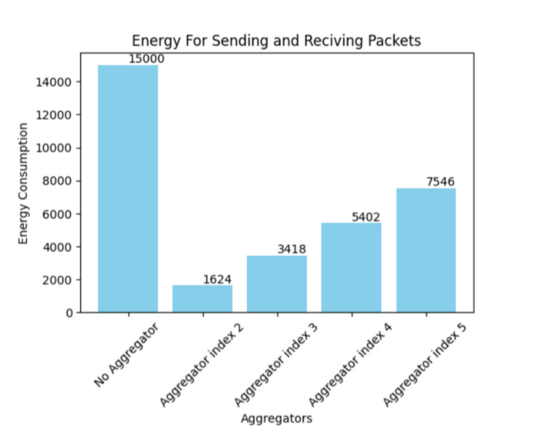
ENERGY ANALYSIS

Slide 10
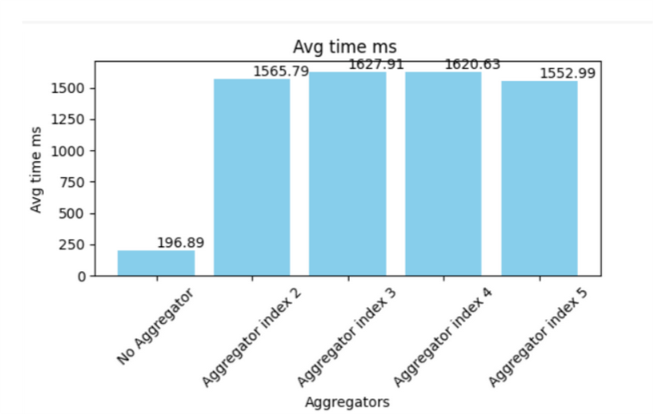
AVG-TIME ANALYSIS

Slide 11
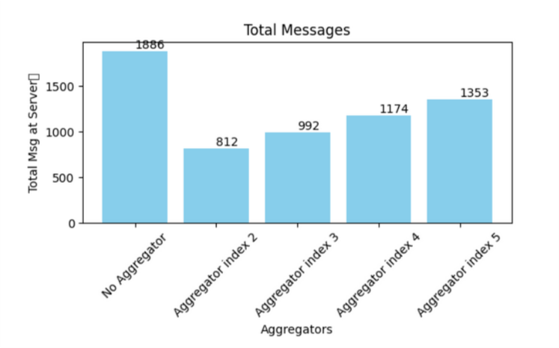
TOT.MESSAGE ANALYSIS

Slide 12
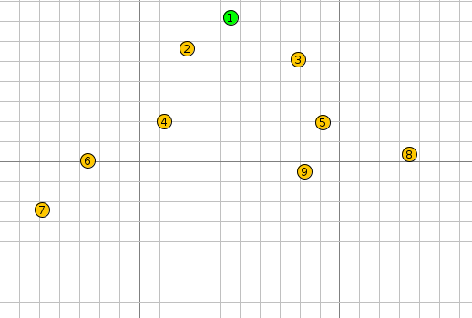
Analysis Based on Number of Aggregators Used
Topology used

Slide 13
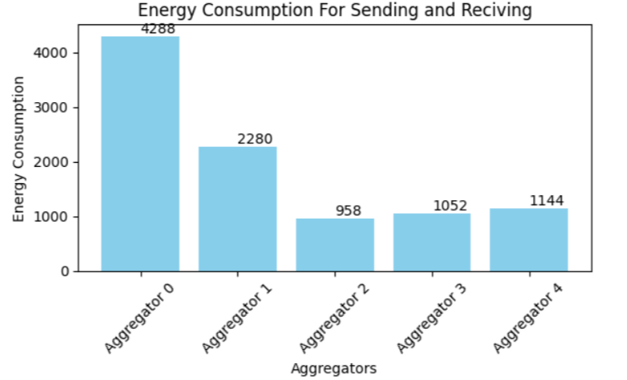
ENERGY ANALYSIS

Slide 14
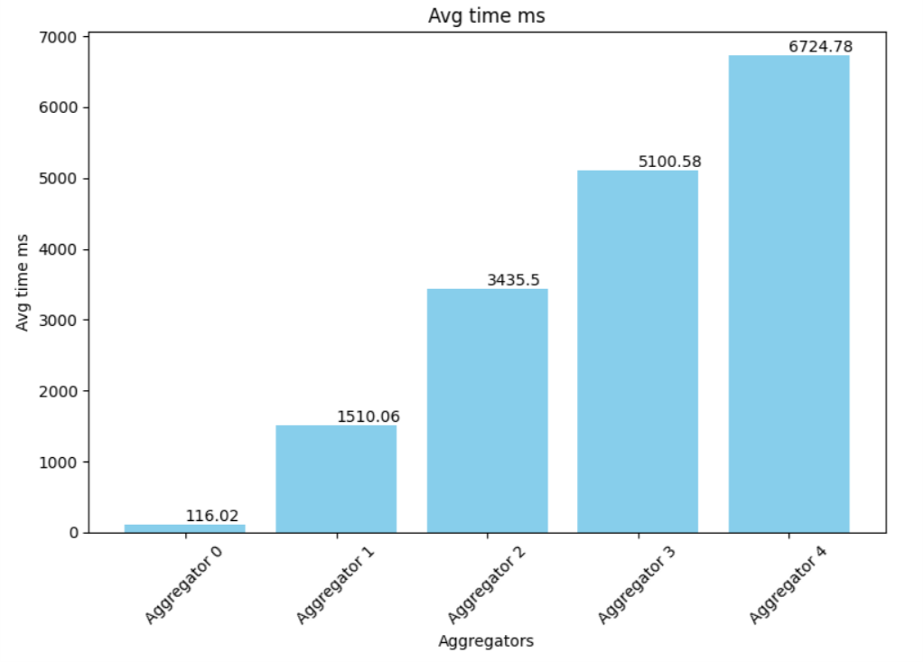
AVG-TIME ANALYSIS

Slide 15
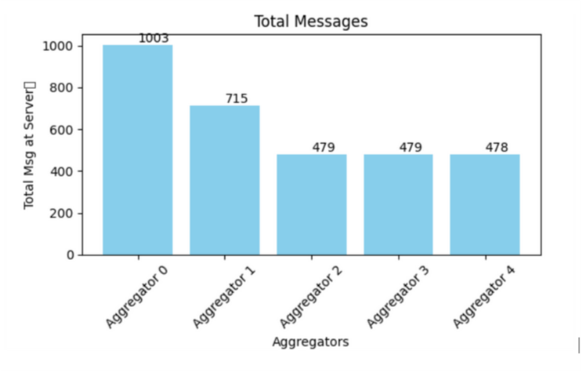
TOT.MESSAGE ANALYSIS

Slide 16
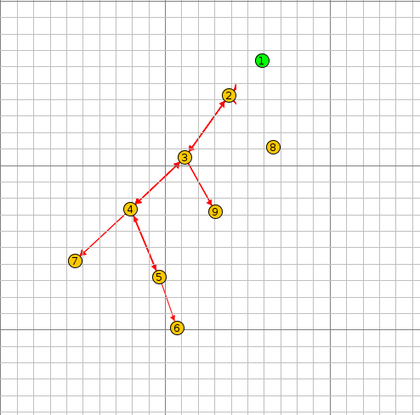
Analysis Based on Position of Aggregators
Topology used

Slide 17
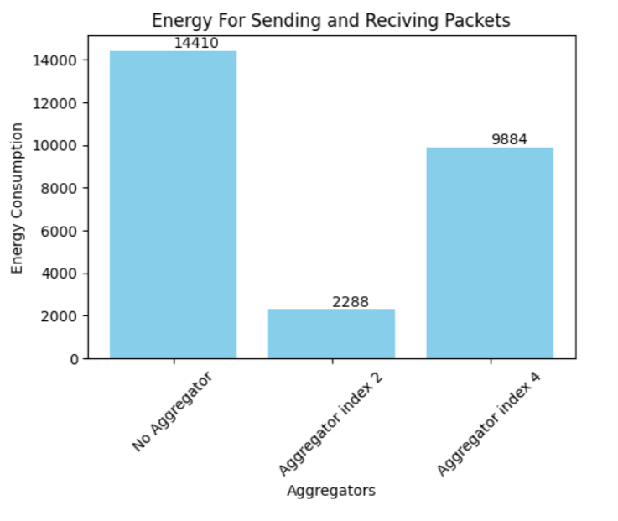
ENERGY ANALYSIS

Slide 18
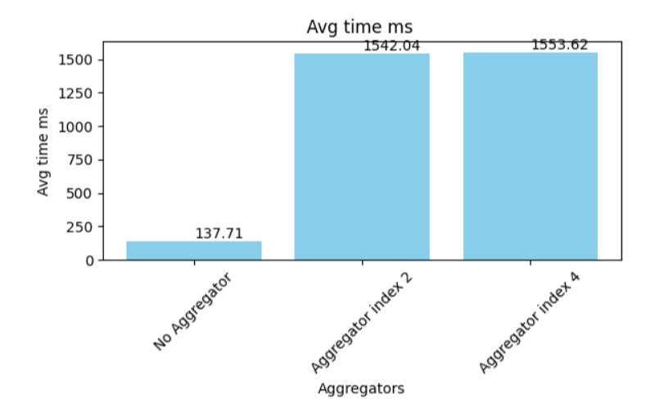
AVG-TIME ANALYSIS

Slide 19
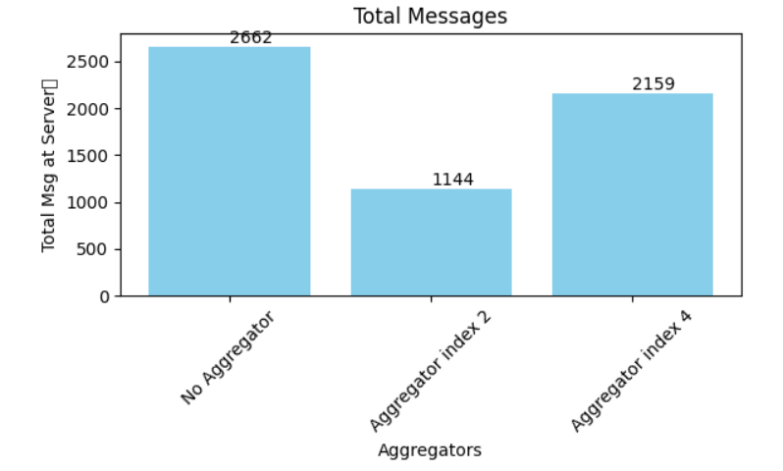
TOT.MESSAGE ANALYSIS

Slide 20
Thank You

